Slide 1
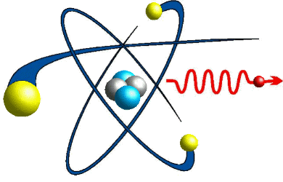

Hybrid Electrostatic Ion Beam Trap (HEIBT): design, simulation & fabrication of a setup for cold ion-ion collision
Raj Singh
Department of Particle Physics and Astrophysics
Weizmann Institute of Science, Rehovot, Israel
MICE, 21 November 2019

Slide 2
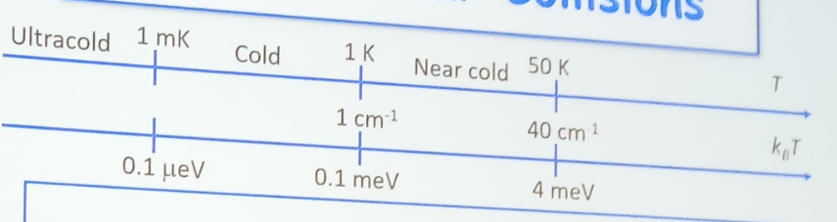
Motivation: cold collision?
Cold molecular collisions
Near Cold collisions

Slide 3
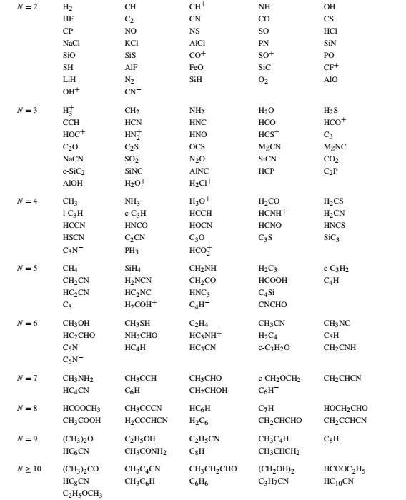
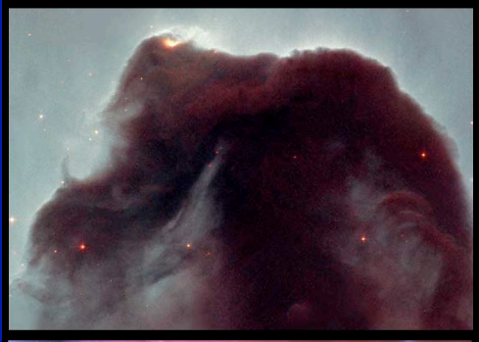
Motivation: why molecular ions collisions?
Interstellar medium
Importance: Interstellar cloud chemistry modeling, [Astrophys. J. 652, L141 (2006)]
planetary science and plasma Physics
Anions: C₆H⁻ , C₄H⁻, and CN⁻ etc. [Rep. Prog. Phys. 75, 066901 (2012)]
A⁻ + B⁺ A + B (Mutual neutralization)
A⁻ + B AB + e⁻ (Associative detachment)
A⁻ + hν A + e⁻ (photo detachment)

Slide 4
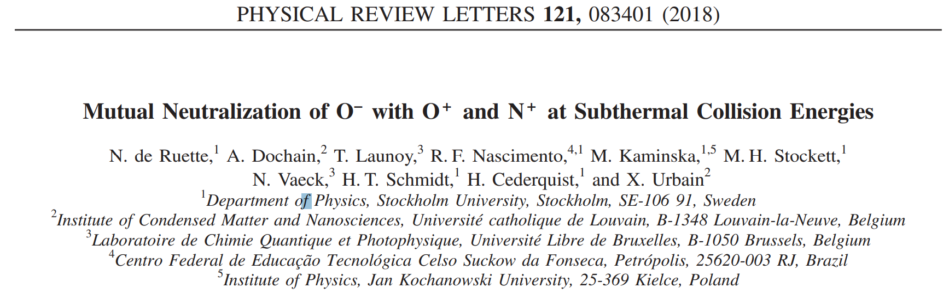
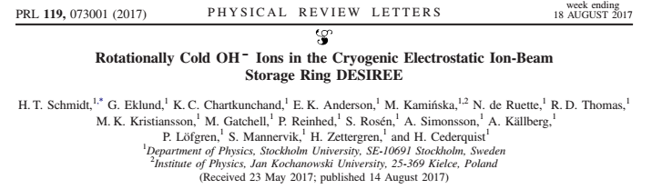
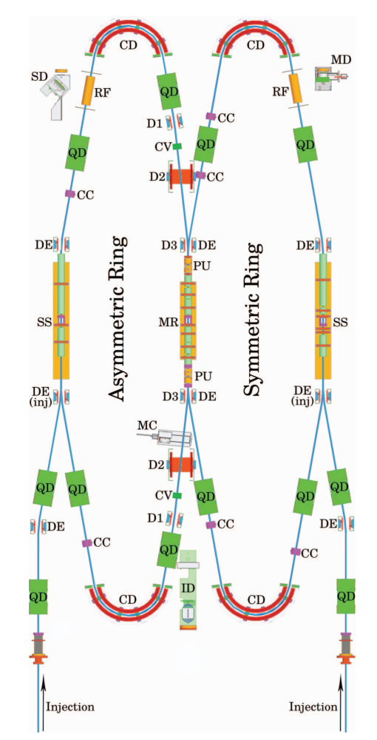
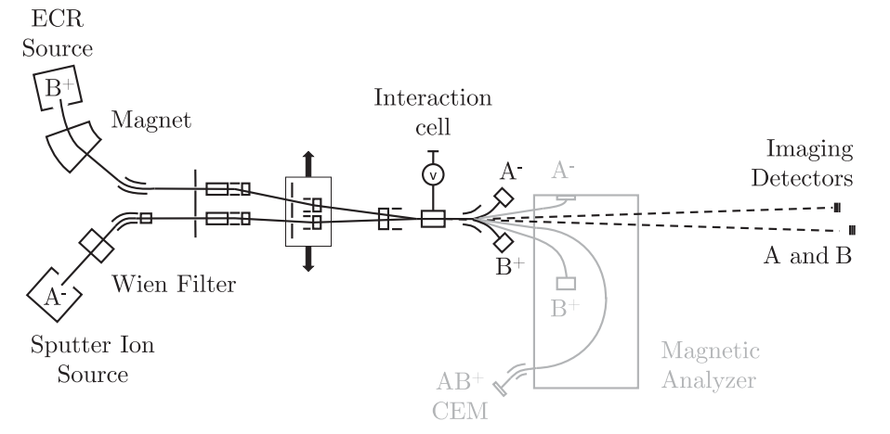
Motivation
Single Pass experiment
DESIREE
Hybrid MOT and Paul trap
Hybrid electrostatic ion beam trap

Slide 5
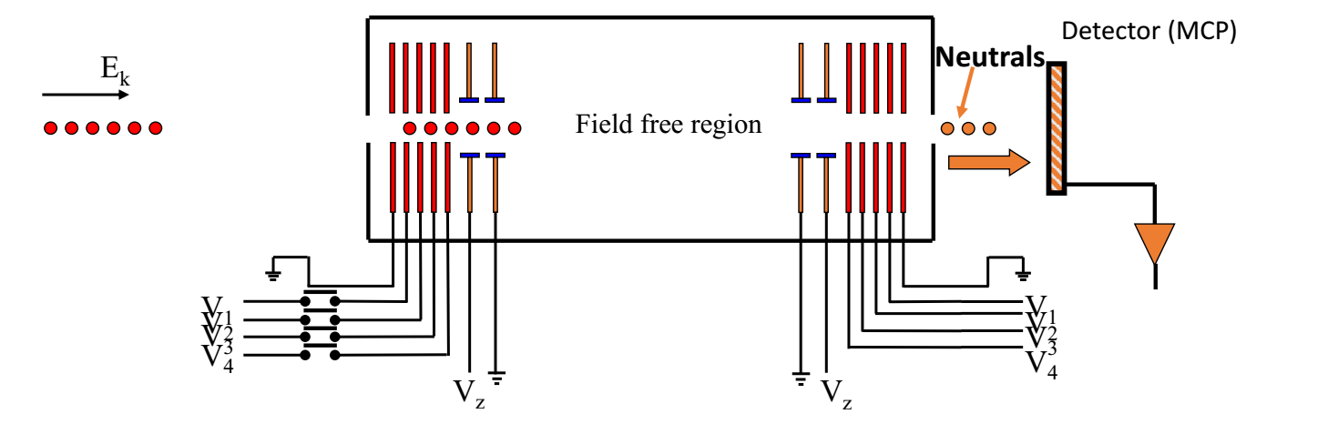

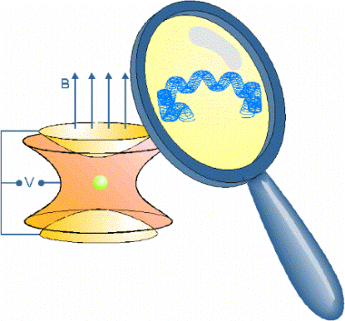
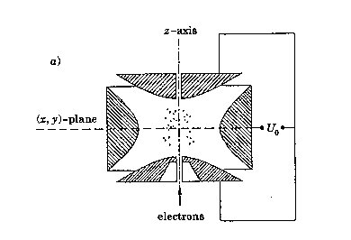
Electrostatic ion beam trap (EIBT)
Trapping ion beams at keV energies
Photon optics: resonator
R
R
L
Stability condition for a symmetric resonator:
Why is this trap different from the other traps?
No magnetic fields
No RF fields
No mass limit
Large field free region
Simple to operate
Directionality
External ion source
Easy beam detection
Penning trap: DC electric
+ DC magnetic fields
Paul trap: DC + RF electric fields

Slide 6
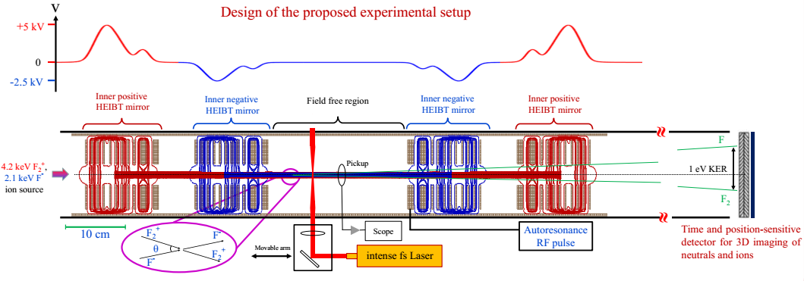
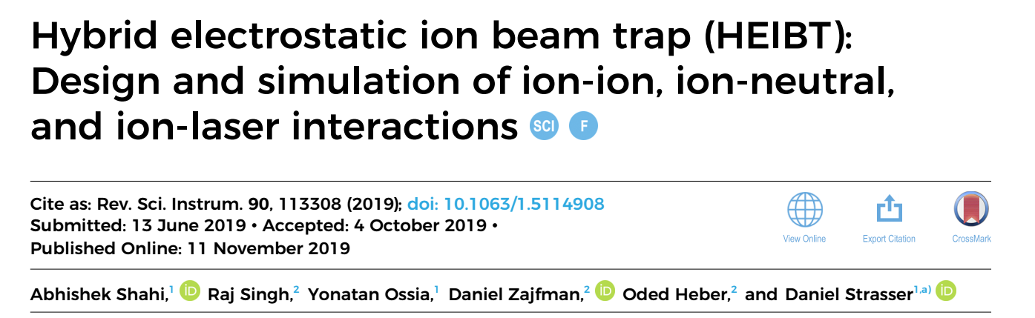
Design of the proposed experimental setup

Slide 7
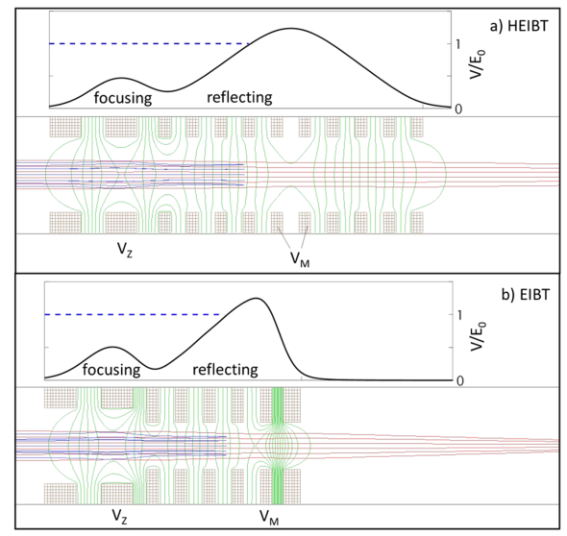
Mirror design: ‘Dichroic’HEIBT vs EIBT

Slide 8
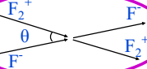
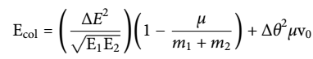
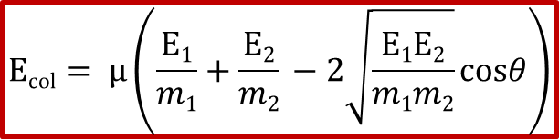
Merge beam collision energy in CM frame
Collision energy is give by:
$$Ecol= μ\left(\frac{E1}{m1}+\frac{E2}{m2} −2\sqrt{\frac{E1E2}{m1m2}}cosθ\right)$$
Under the velocity matched and small angle condition :
Δ

Slide 9
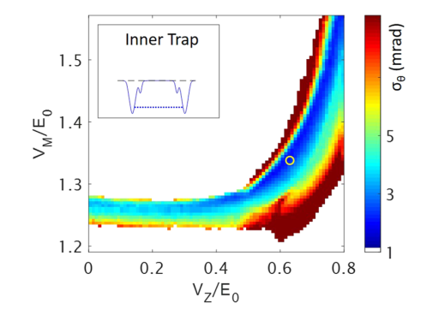
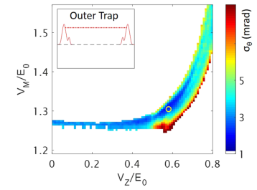
Mirrors voltage optimization

Slide 10
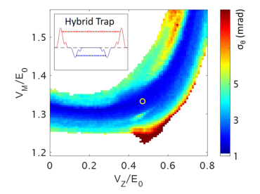
Mirrors voltage optimization HEIBT

Slide 11
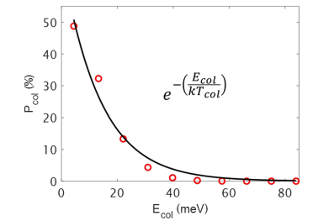
Collision temperature fit
Injected beam parameters: 4 mm diameter and 5 mrad angular at optic axis
The distribution of collision energy (E_{col}) and fit for collision temperature, kT_{col} = 13 ± 3 meV, in the given equation.

Slide 12
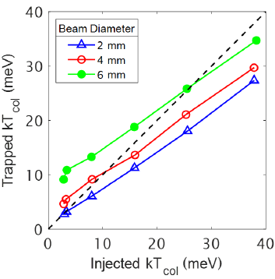
Trapped beam vs injected beam temperature

Slide 13
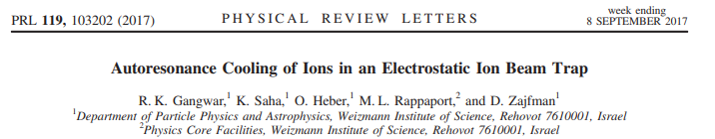
Autoresonance cooling of ions
Cooling the translational degree of freedom
An order of reduction in the standard deviation has achieved, which is equivalent to the velocity reduction from 1000 m/s (without AR ) to 6 m/s (After AR with threshold voltage V_{d0}) which is well below 1 Kelvin.

Slide 14
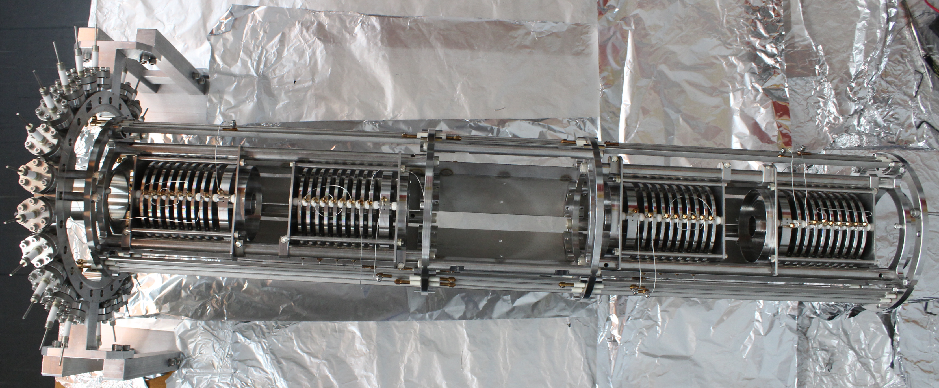
HEIBT’s trap mirrors

Slide 15
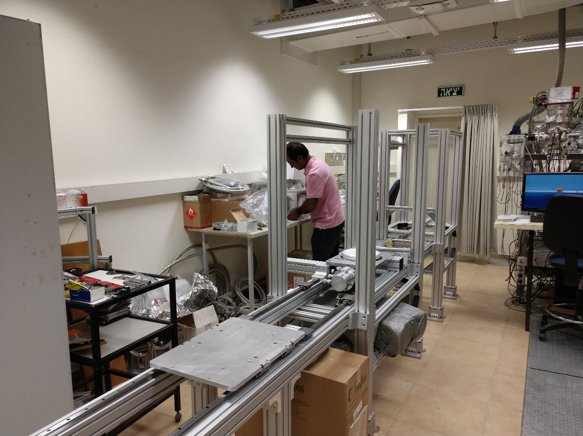

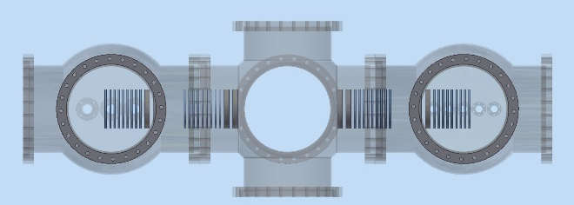
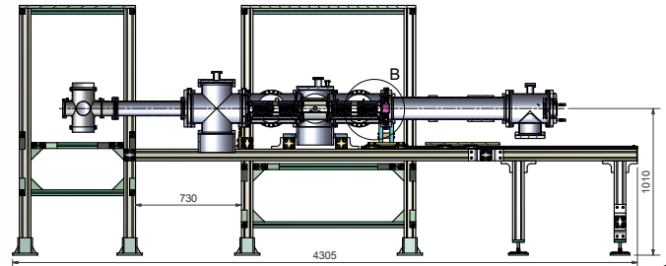

Slide 16
Summary
The HEBIT is designed and simulated to trap positive and negative ions simultaneously in velocity matched condition.
The HEBIT design offers a versatile setup for cation-anion , ion-laser and ion-neutral interactions.
Multiple neutral and cationic products can be recorded behind the electrostatic mirror on a 3D coincidence imaging detector.
The elements of proposed experimental setup have been fabricated and being assembled. We anticipate first test result in the starting of next year. The setup will be installed in Hebrew University.
POSTER: 18:30 Today

Slide 17
Acknowledgements
Collaborators
Weizmann Institute of Science, Israel
Prof. Daniel Zajfman
Dr. Oded Heber
Dr. Michael Rappaport
Dr. A. Shahi
Hebrew University of Jerusalem, Israel
Prof. Daniel Strasser

Slide 18
Thank for your kind attention!

